Slide 1
Data upload to the Brassica Information Portal
Workshop- uploading population and trial scoring data
Annemarie Eckes
Data Curation, Plant Phenotyping
Notes:
We are developing the Brassica Information Portal as a resource that collects, integrates and analyses phenotypic data from pre-breeding experiments on Brassica crop species.
The Portal will facilitate Brassica crop breeding with a data-driven approach: The data collected from phenotyping experiments are made accessible and available in a standardised manner. This data can be integrated with genotypic information. In the future, associative analysis tools will enable on the fly analysis between traits hosted in the Portal and external genotypic information.

Slide 2
Introduction, features, research cycle
Different information sides and what ontologies are being used
Trial “ontology” under development- extended MIAPPE and elixir
Show Database interface and do some navigation
Wizard and API submission
(Upload a plant population and plant: https://github.com/TGAC/BIP_training)
Github:how to download the repo and install all dependencies
Use CropStore schema- used for other crops, too. Schema version 7.0
Future extensions
acknowledgements

Slide 3
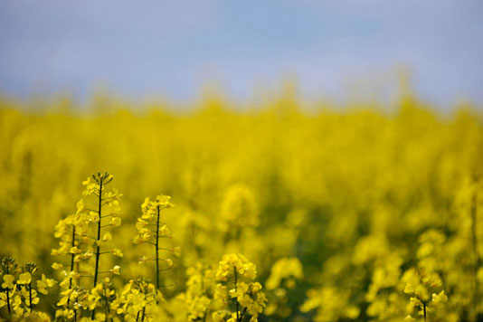
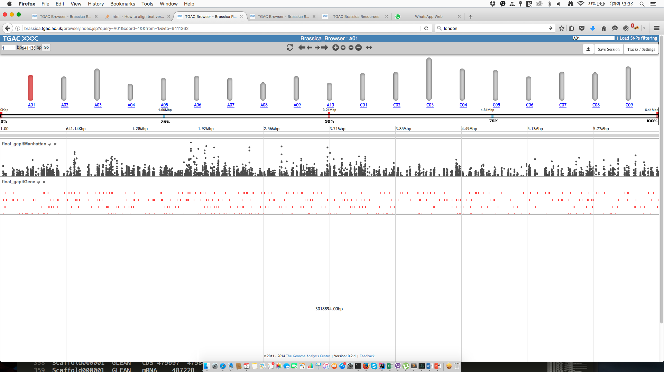
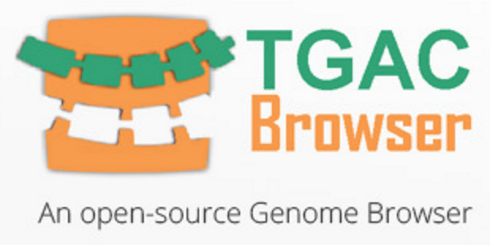
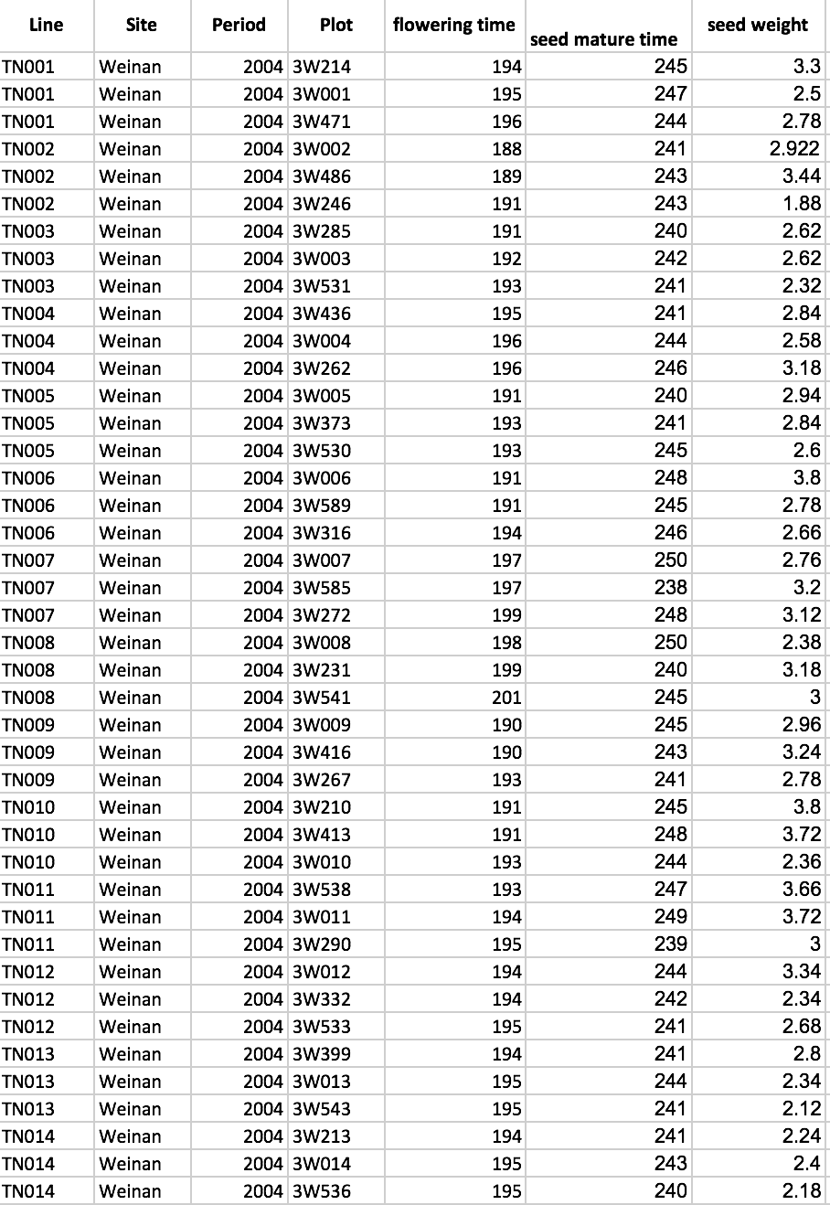

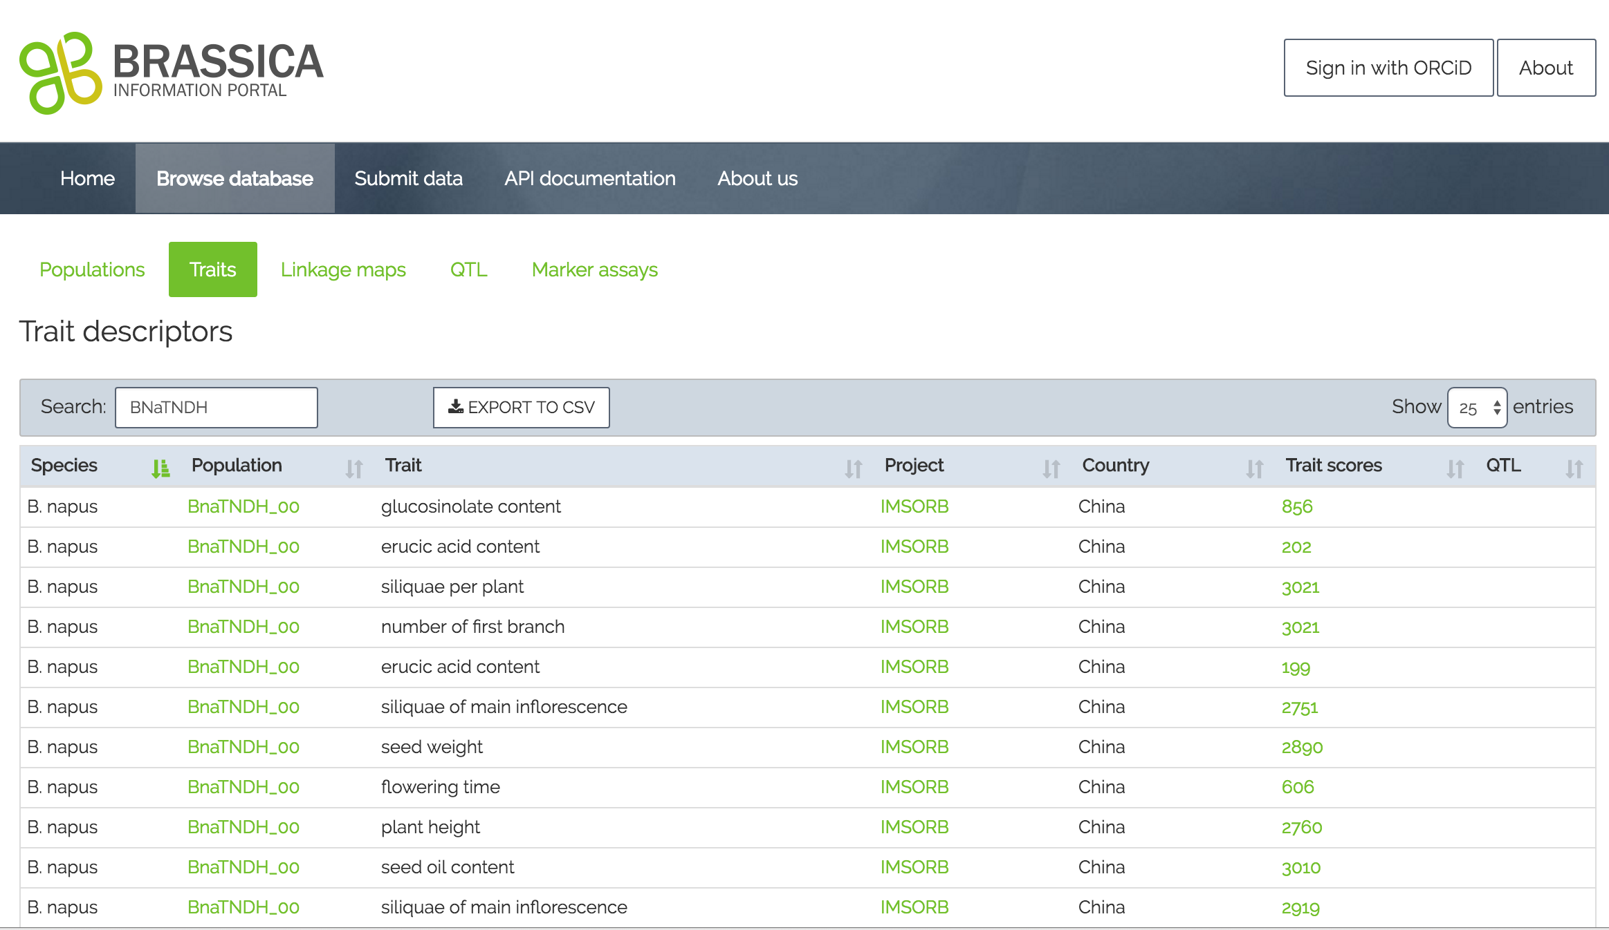

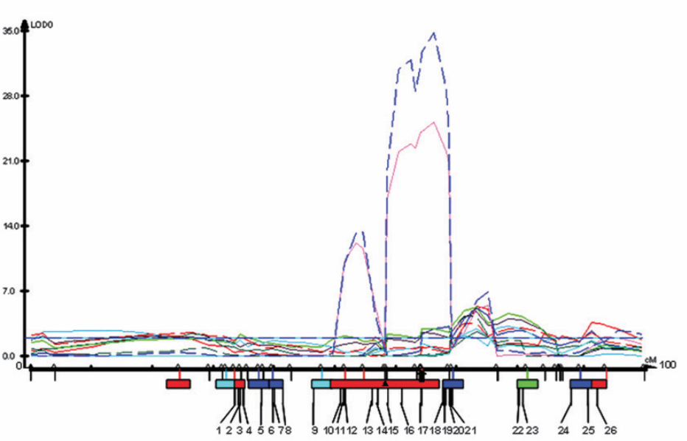
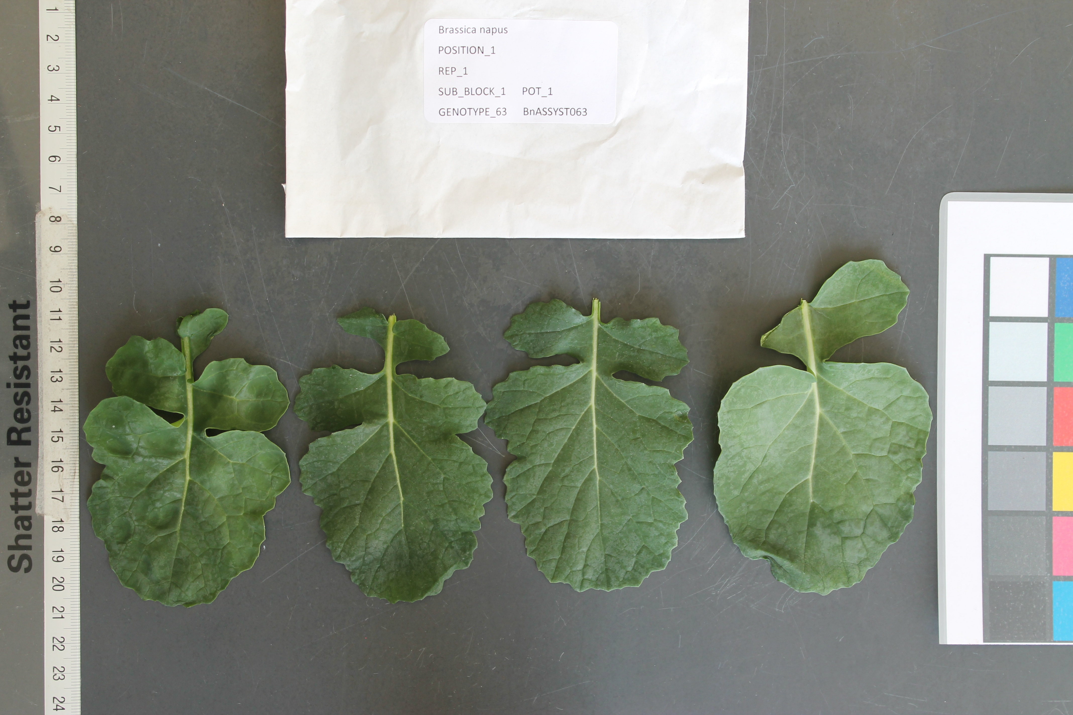



BIP integration with other resources
Extended submission, cross-linking, analysis, publishing
Notes:
The original “direction”/way of Using the BIP is linear: Data can be stored and accessed for downstream analysis. It is simply a “repository” of trait scoring data for Brassica crops.
But we are working on extending and cross-linking its functions, some of which I will present later. For example, we have made it possible to submit image names and draw from CyVerse as a default resource to cross-link the image names submitted to BIP.
Extension: make user submit image data alongside with measurements. The images will automatically be stored in CyVerse as opposed to the user having to do this manually.
The user can now submit sequence identifiers from SRA with the submission, which are automatically cross-linked with the corresponding entry in NCBI.
It is now possible to access the BIP via the TGAC browser. The feature allowing this is dependent on background data uploaded to the Browser by the administrator.
In the background of the brower, SNP information for the RIPR population is loaded. People interested can select lines carrying certain SNPs of interest and compare them with lines not carrying these SNPs. During this analysis, the user can look up the line in the Brassica Information Portal and see any related information about the line there ( e.g. registered trait measurements, origin, Cultivar name, all experiments using that line, etc.., )
-Note that this feature is currently only accessible as a service for the RIPR project, as it is sensitive data.
Legacy data sequences- where possible are cross-linked with Ensembl/ NCBI.
We are working with the CyVerse team to integrate their analytics tools with the BIP.
Latest developments were to obtain DOIs for datasets submitted to BIP.

Slide 4

The Brassica Information Portal in the Research Cycle
Identify pot. collaborators
Meta analysis of data content
Research question
Finding communication
Study design
Get inspired by existing studies
Perform associative analysis with cross-linked genotypic information
Define and submit the traits
( new Ontology terms)
Data analysis
Data collection
Data submission
Perform on-the-fly statistical analysis of phenotypic raw data and compare with existing studies
Have metadata and trait data ready
Notes:
All possible interactions the Brassica Information Portal can have with the Research Cycle in plant breeding research.
The Portal can be integrated in all aspects of Brassica research from generating a research question and collaborations from selecting or defining new traits to measure, through data handling and storage to associative analysis.
Also a summary slide for what I have done and future developments.

Slide 5
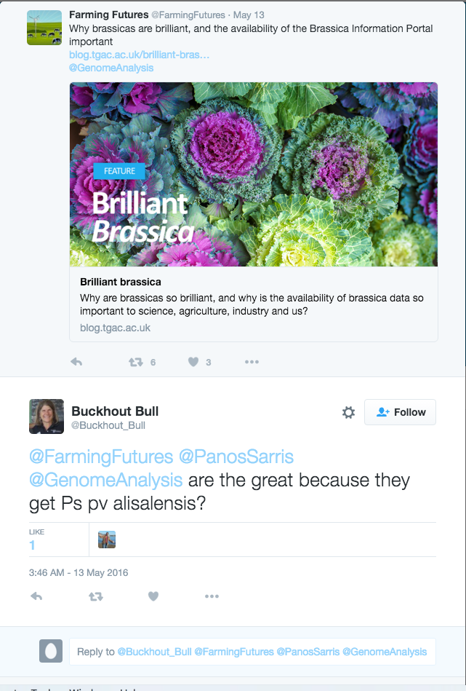
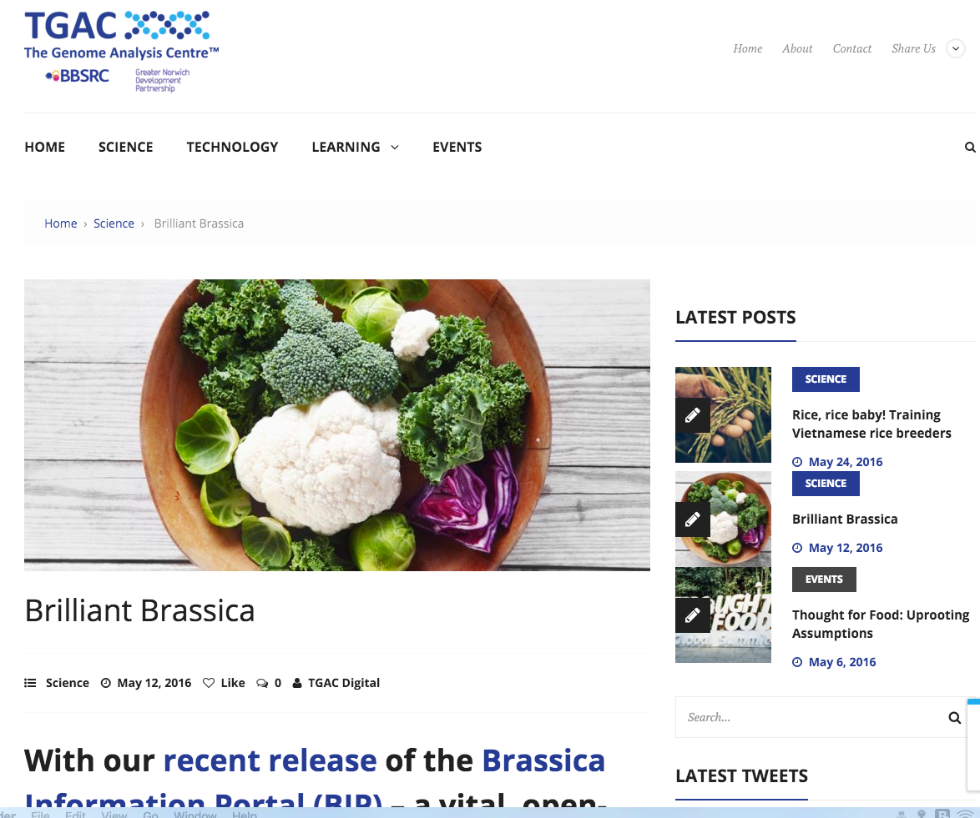
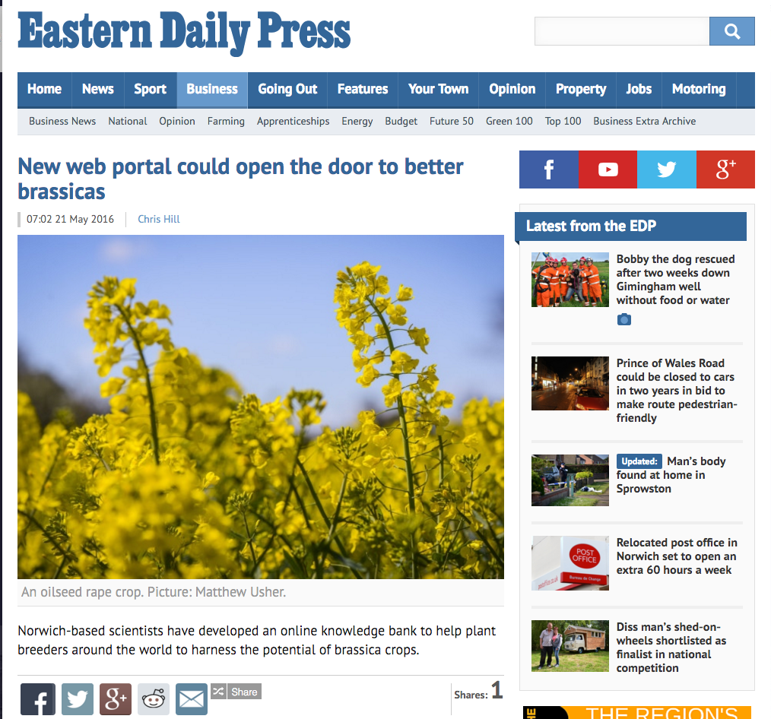
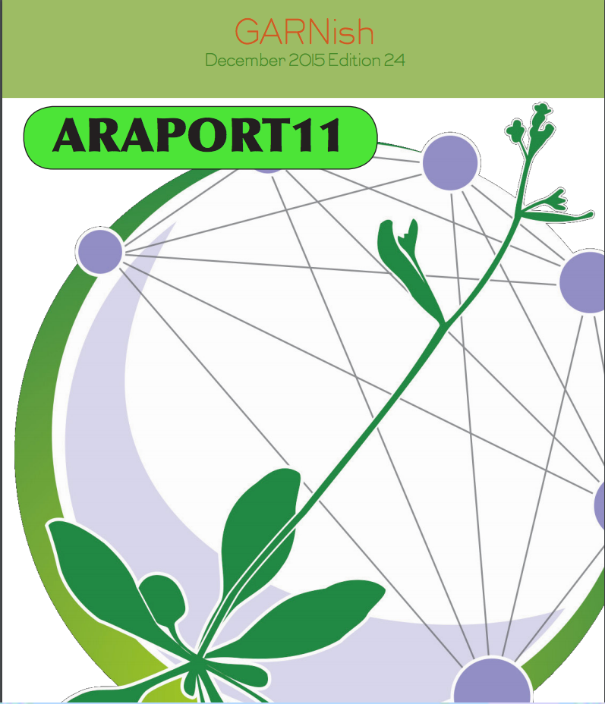
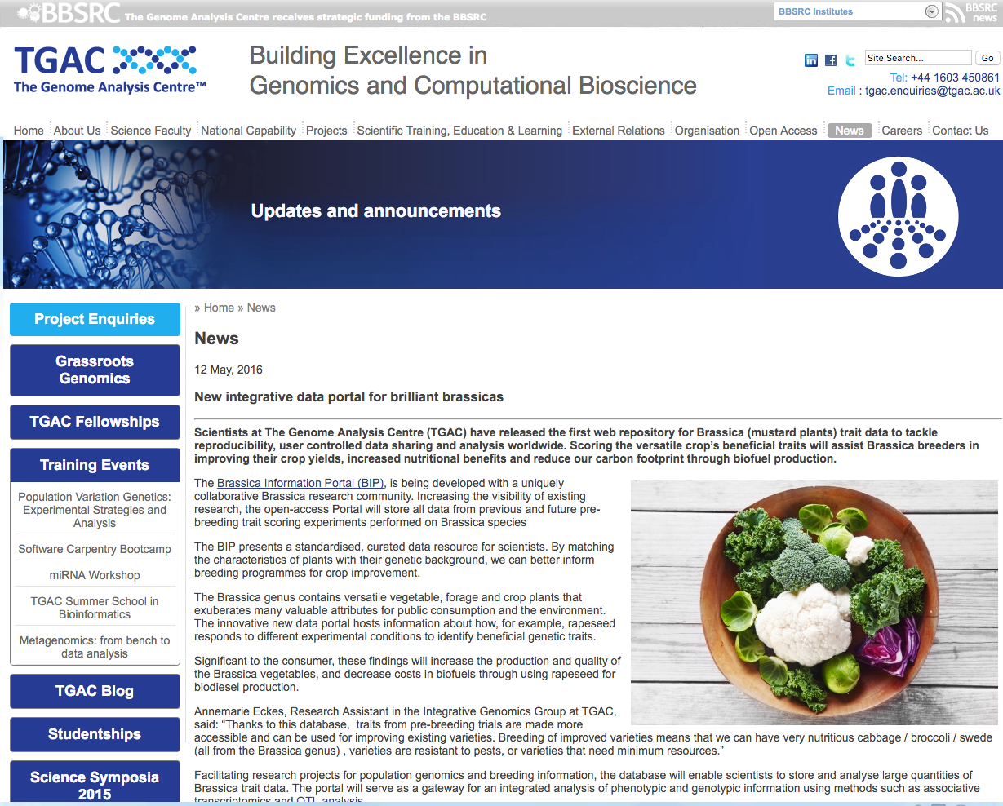
in the media

Slide 6
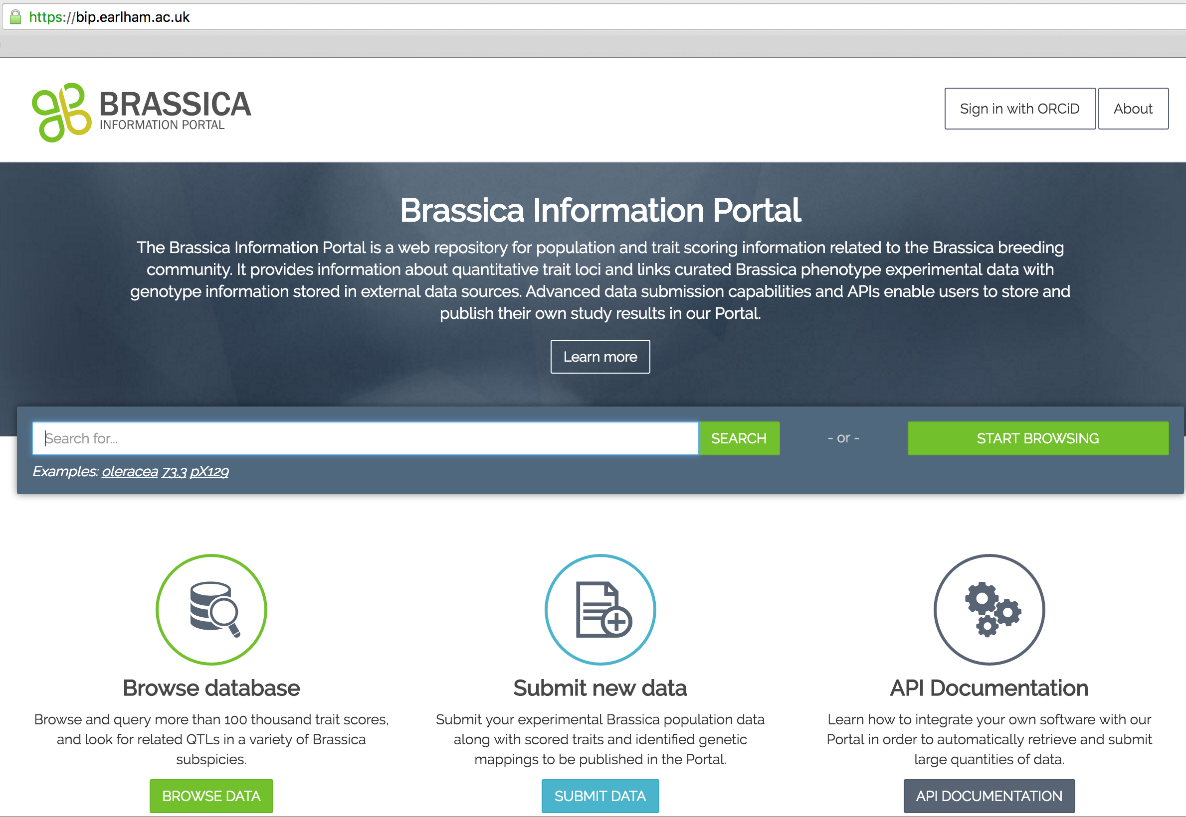
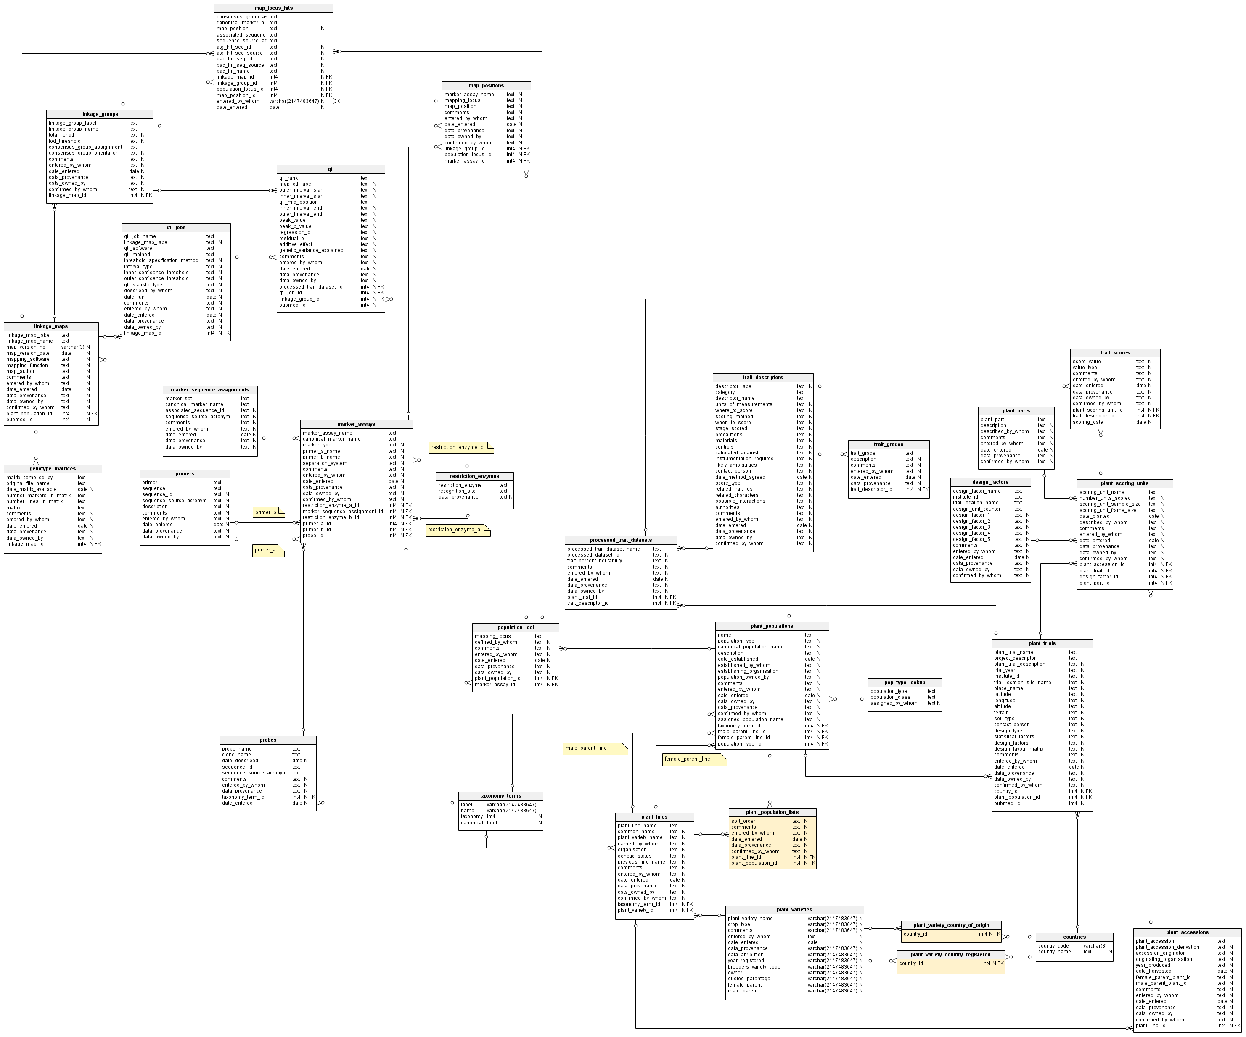
Data upload to BIP
The Brassica Information Portal interface and underlying schema
Notes:
Beneath the shiny web- interface is a complicated system of tables, that interact.

Slide 7
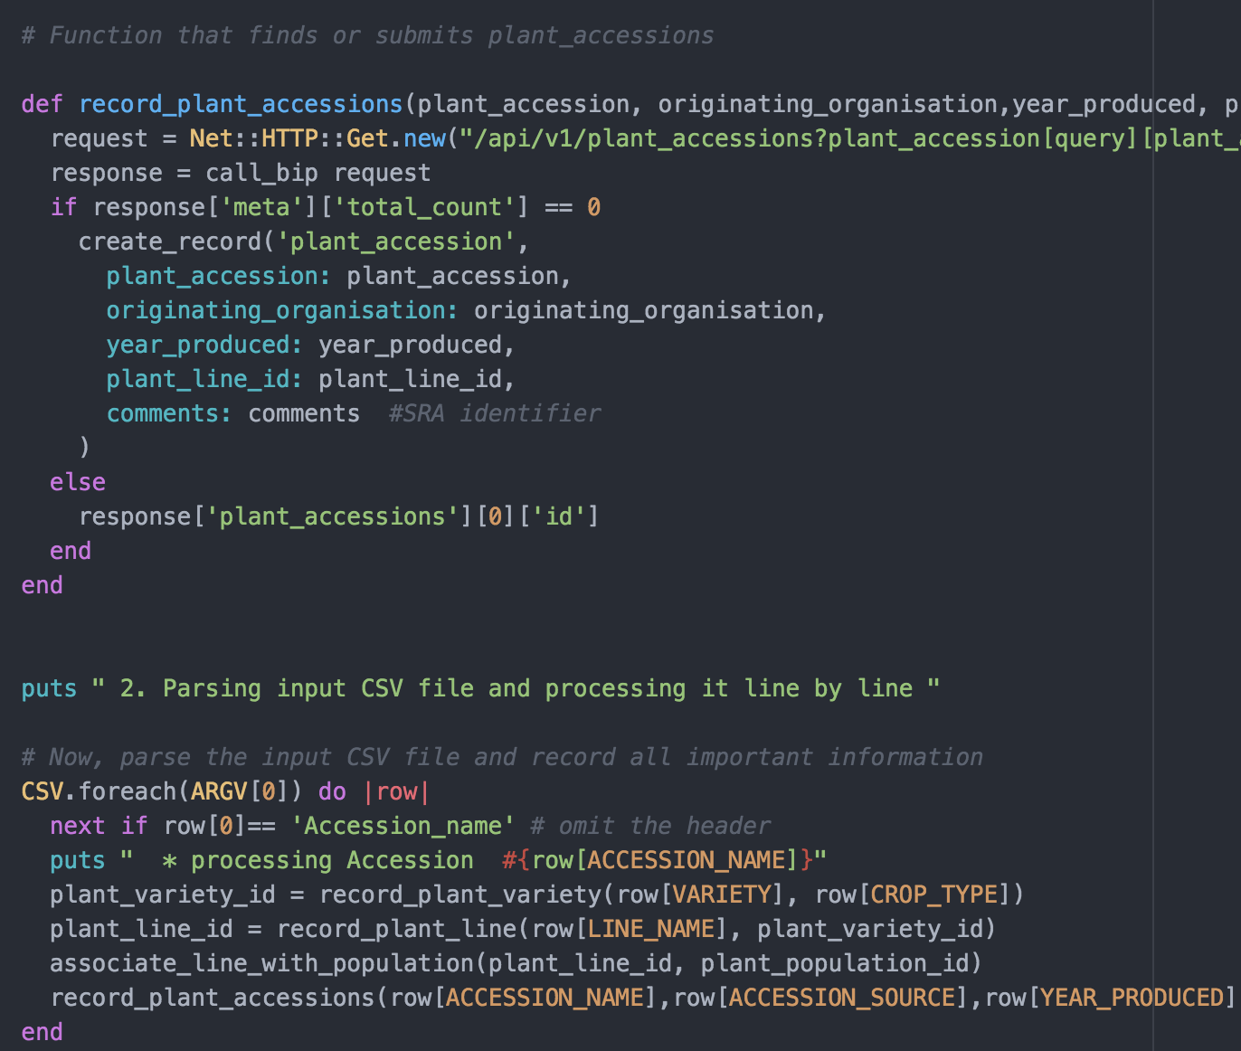
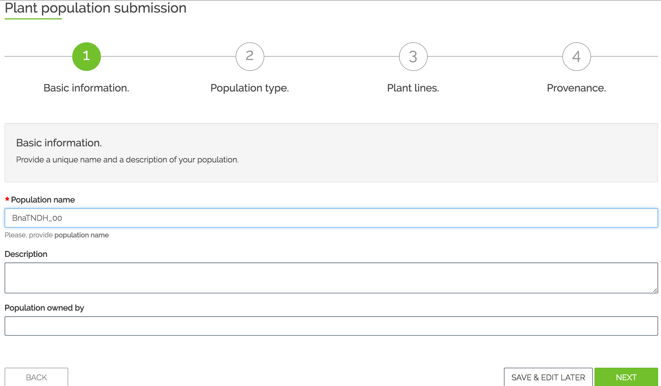
The BIP database schema
Trial Submission
Population Submission
Notes:
In this workshop , we are going to interact with these tables of the database

Slide 8
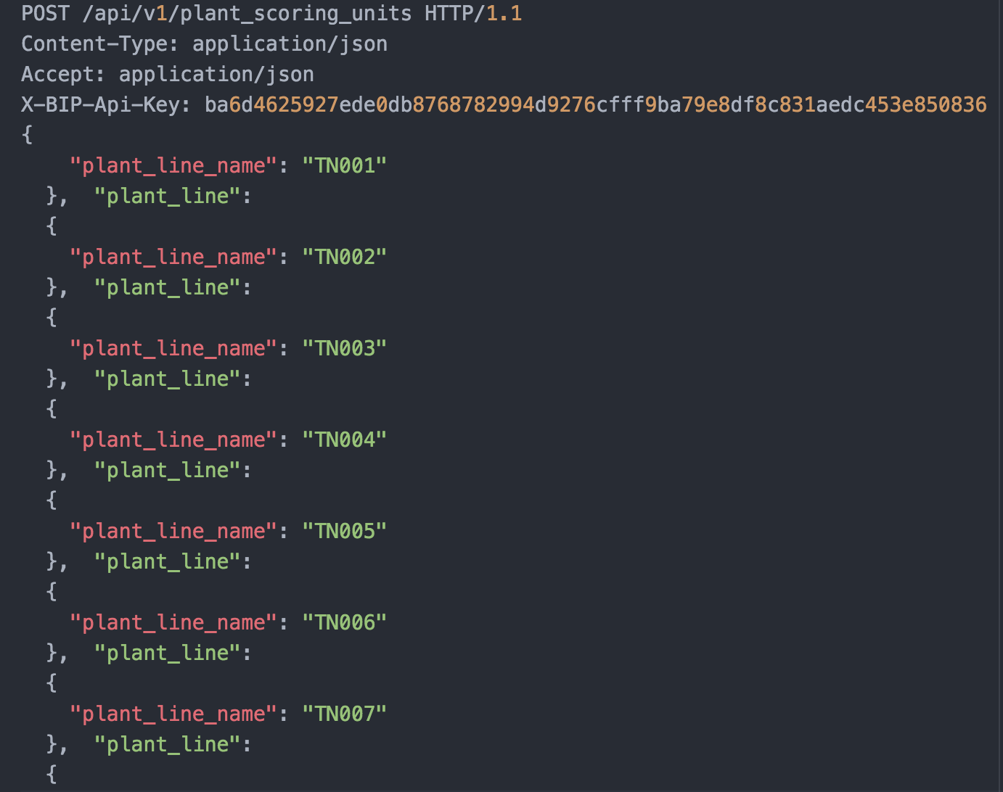
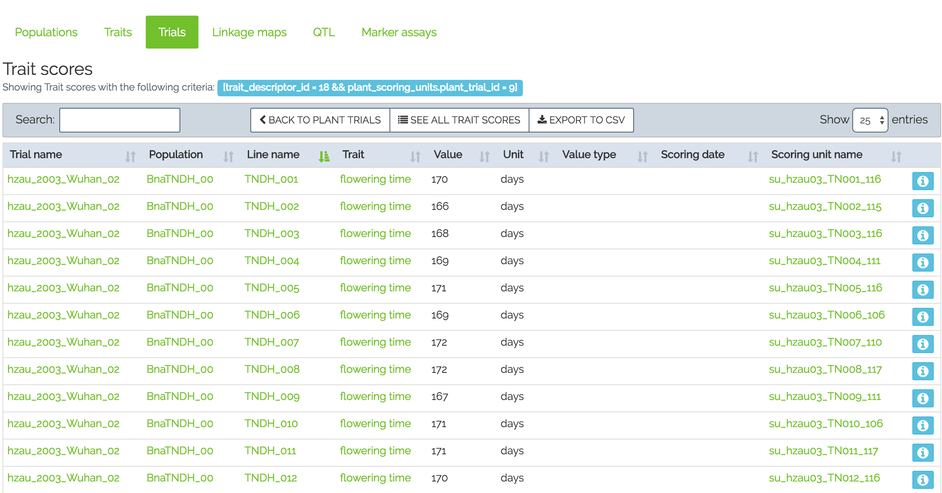
Different ways to communicate with the BIP
Programmatic submission – Population Submission
API layer
Web layer
Wizard based – Trial Submission
HTTPS
Notes:
in the Population submission, we will interact programmatically ,and in the Trial submission, we will interact with the database using the schema.

Slide 9
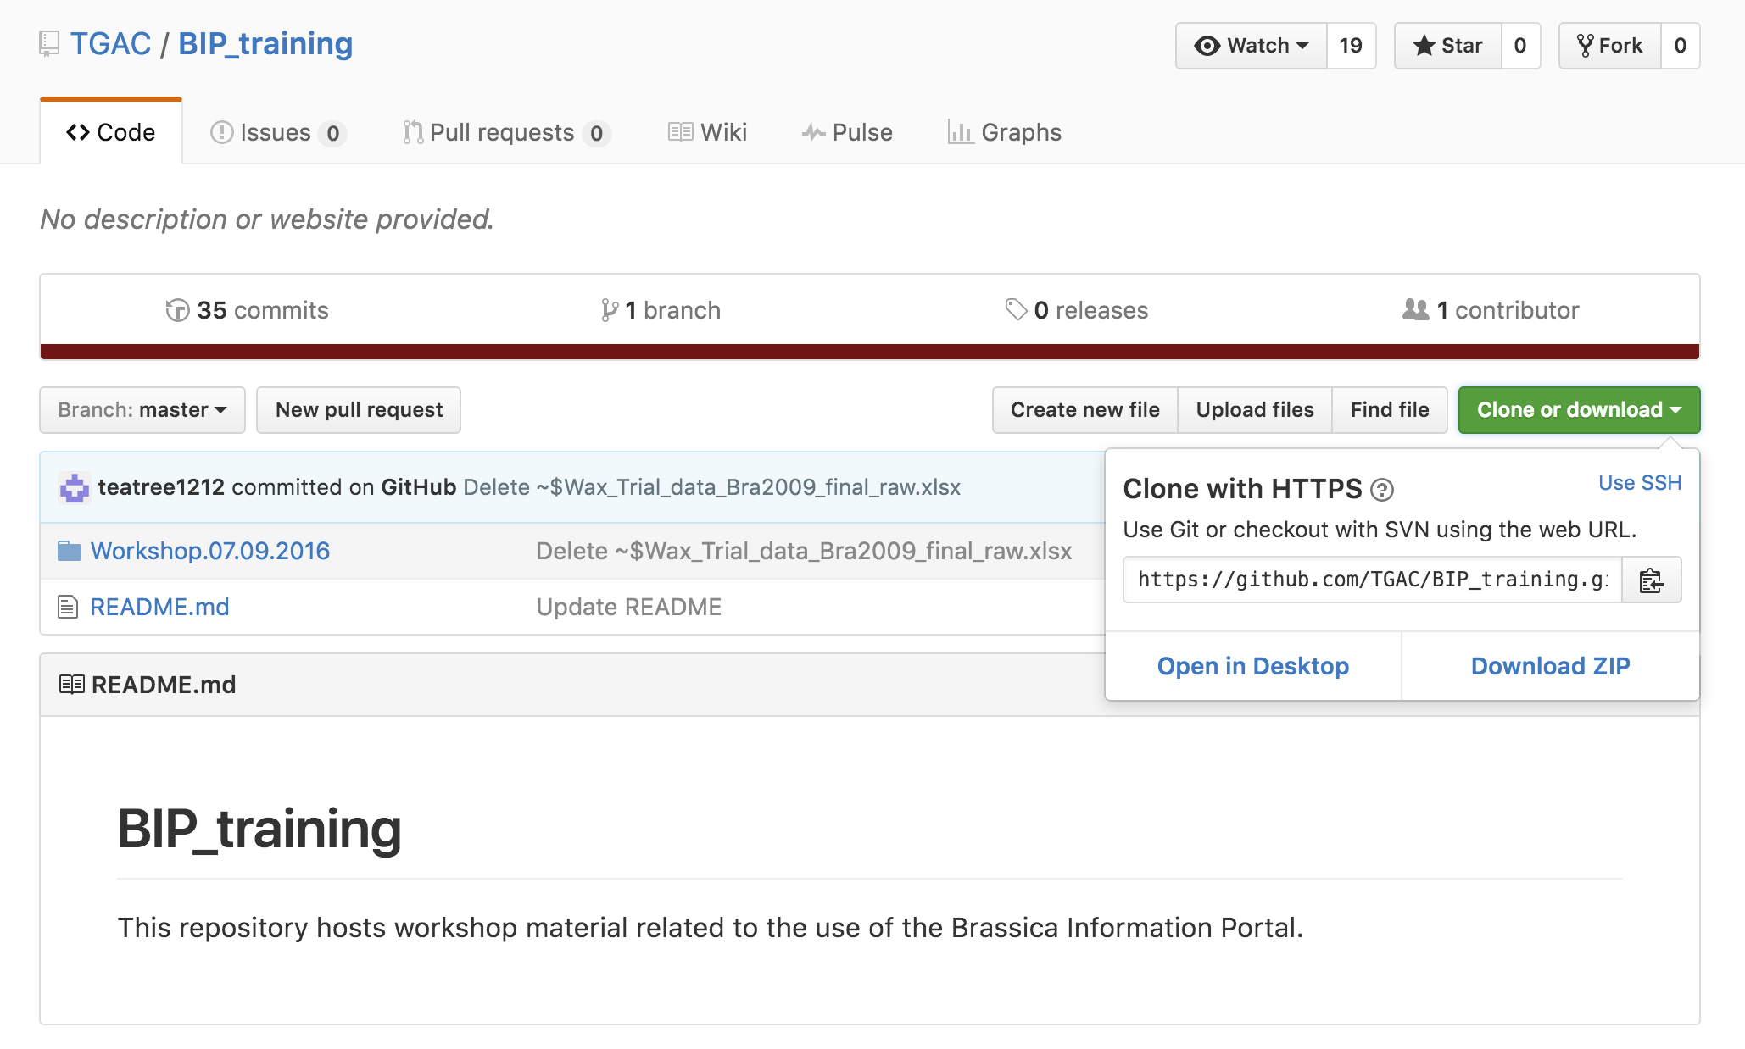
Access to workshop material
Please follow the link https://github.com/TGAC/BIP_training in your email.

Slide 10
Break
Any questions with regard to software download?
BIP-user account created?

Slide 11
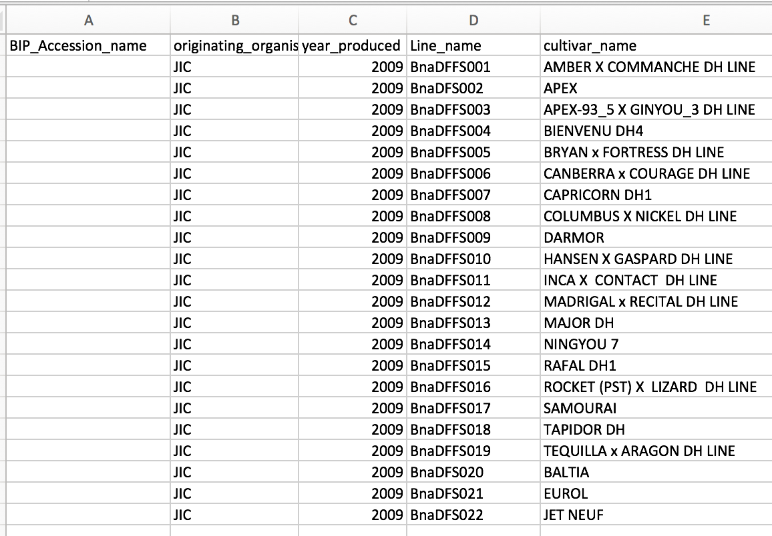
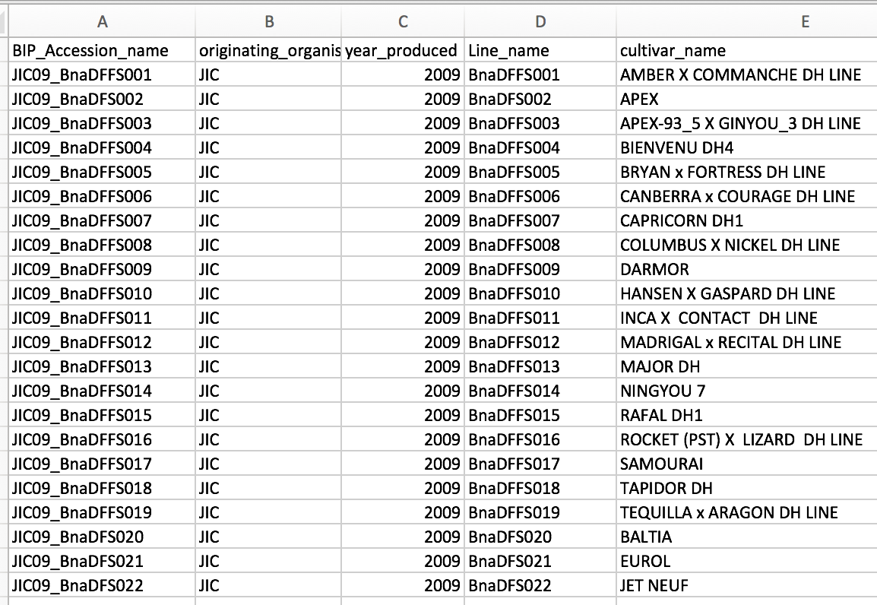
Population Submission using the ruby client
Population metadata
Brassica napus Diversity fixed foundation set -> line names
Seed bulked up at JIC in 2009
Assign identifier to the germplasm used
Nomenclature for Accession:
<Institute abbr.><YY>_<line name>
FILE: 1_BnaDFFS.csv
Notes:
During this workshop we will be using mock-datasets , with Line and cultivar names from a Diversity fixed foundation set established in 2009.
Imagine, you have retrieved some seeds from that set for an experiment.
The mock data on the slide shows that the seed for the experiment has been bulked up at JIC in 2009.
Other mock data has ben bulked in 2010 or at Rothamsted or Nottingham in other years.
In order to account for the Genetic drift/ selection/ cross-pollination/other problems could happen during bulking,
the material may not be as “clean” as one thinks. Therefore, the accessions in the BIP are there to record this. Accessions are derived from the Isntitute where they have been bulked, the year they have been bulked, and the line name the seed originally came from.

Slide 12
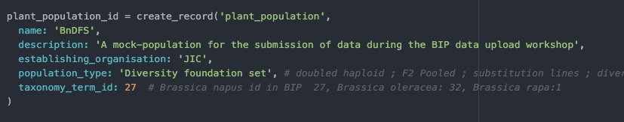
Population Submission
Help from the ruby client:
Population_submission.rb
Notes:
So how do we submit information about the trial and all the lines, accessions and other metadata from this spreadsheet to all these tables in the database?
For that, we will be using the ruby client.

Slide 13
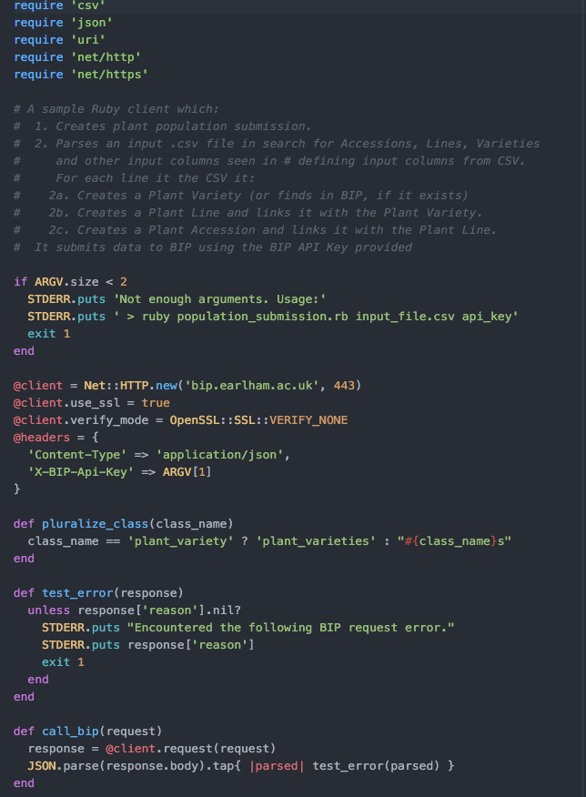
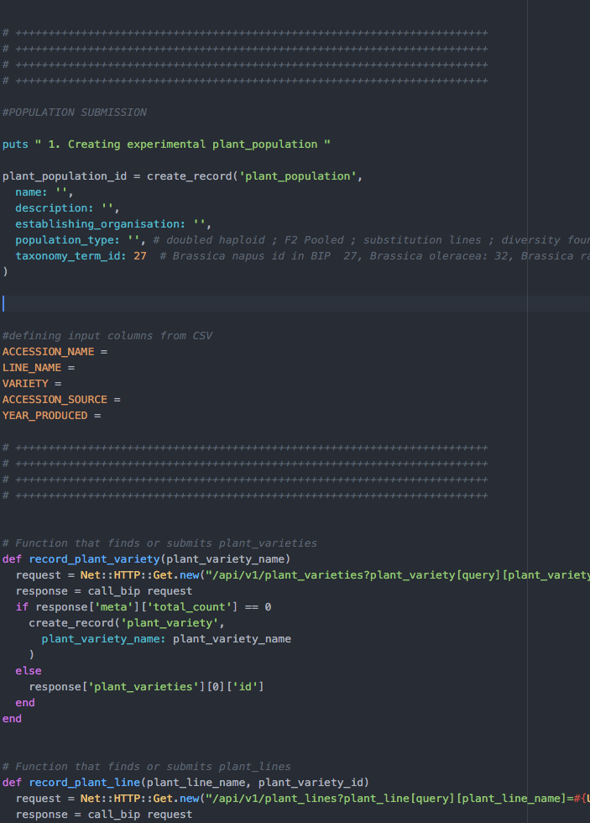
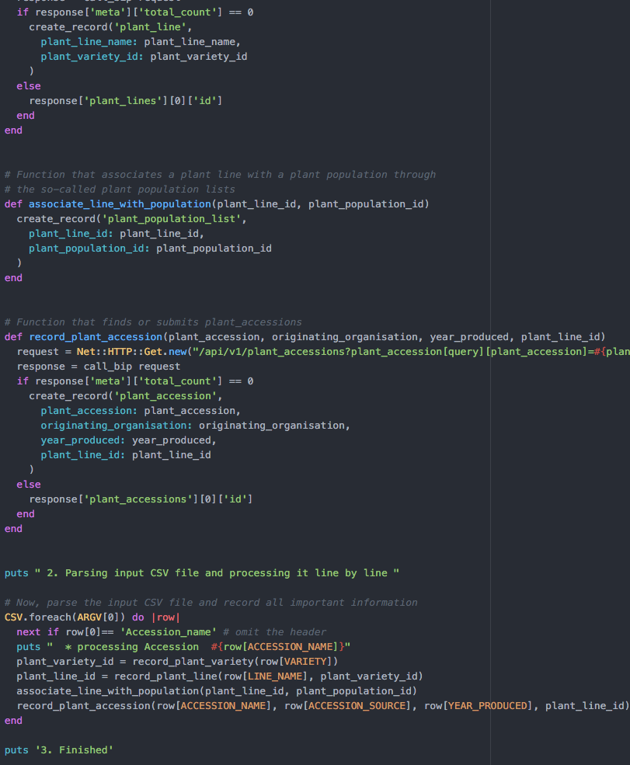
Population Submission using the ruby client
“Header”
Loads software , “dials into database”, defines urls, parameters, error messages
Functions
to fill database tables with content from the .csv –file
-”create_record”
plant population, plant lines, plant varieties, plant accessions
“Body”
FILE:
2_Population_submission.rb
call functions
Notes:
The ruby client Population_submission.rb is a script that helps to send the information from the spreadsheet with the population data into the database.
Here you see its structure. We are just going to work with selected sections of the script, which are marked and we will go through it step by step.
Here I just want to give you a rough overview of the structure:
-its head contains all the ‘administrative stuff’- the interaction and dialing into the database, definition of the url for the API, parameters, error messages
In the Body there are two parts:
one contains the functions, which means they are the bits of the code that define the interactions with specific tables in the database. For the population submission that would be the Population Line Variety and Accession tables.
The other part , just at the bottom calls the functions, and feeds them with content from the .csv –file.

Slide 14
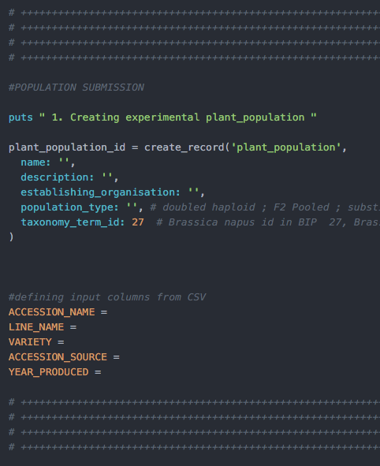
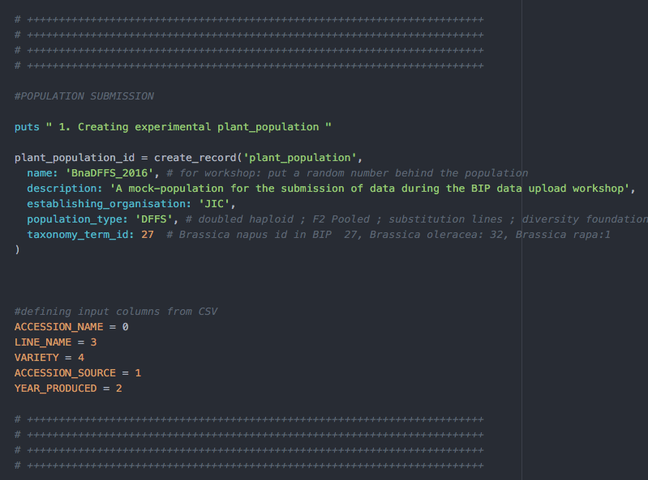
Population submission -defining input columns from your CSV

Slide 15
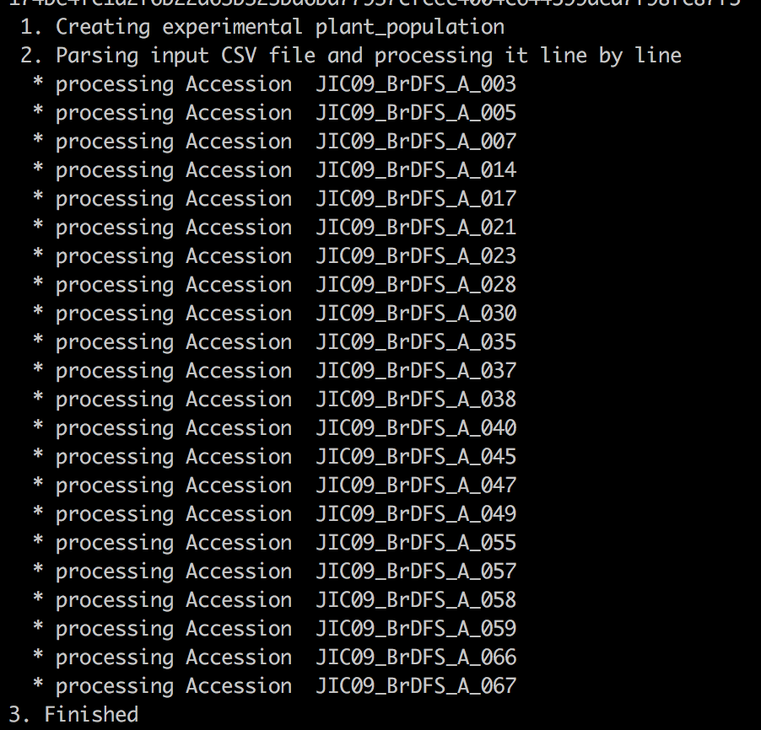
Population submission -run the script
Retrieve API (key) – look in manual for how to find it
Run the script:
ruby population_submission.rb <your_input_file.csv> <your_api_key>
Ruby population_submission.rb 1_BnaDFFS aslsb4js4k1ls04g1lkjiu131409sglkh1394k

Slide 16
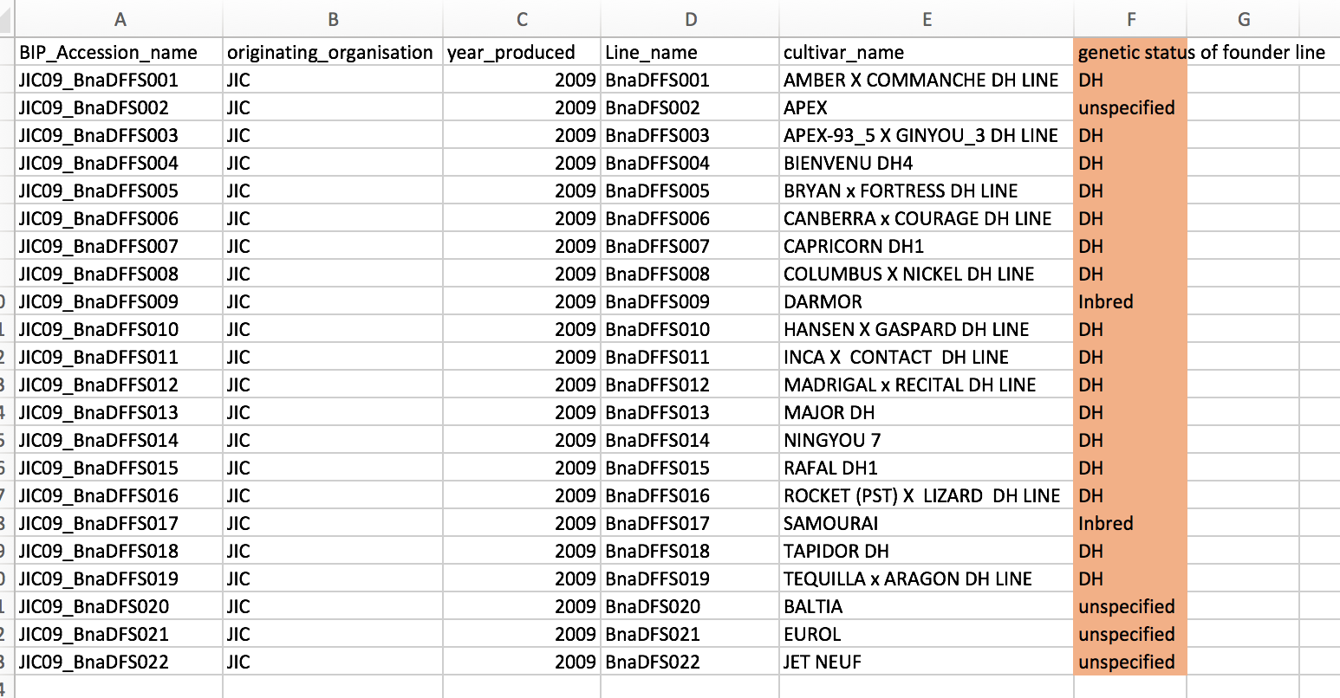
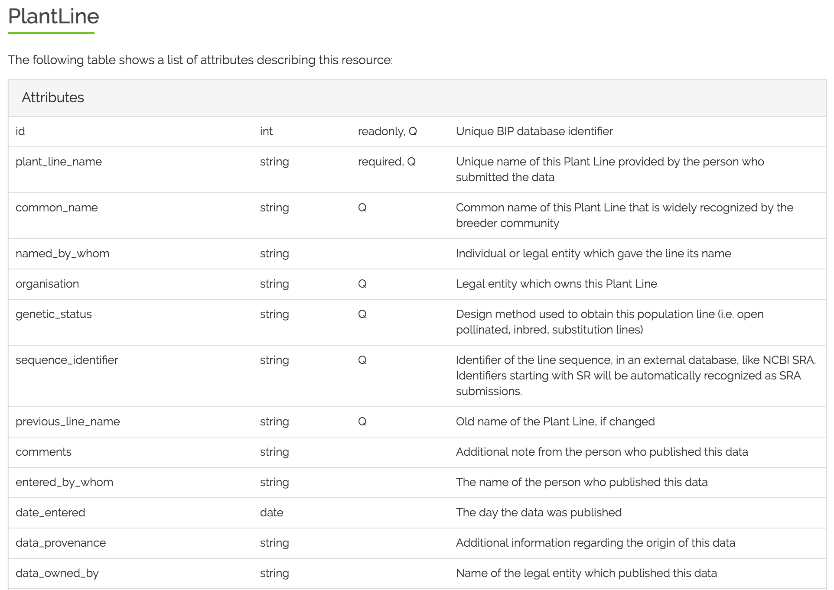
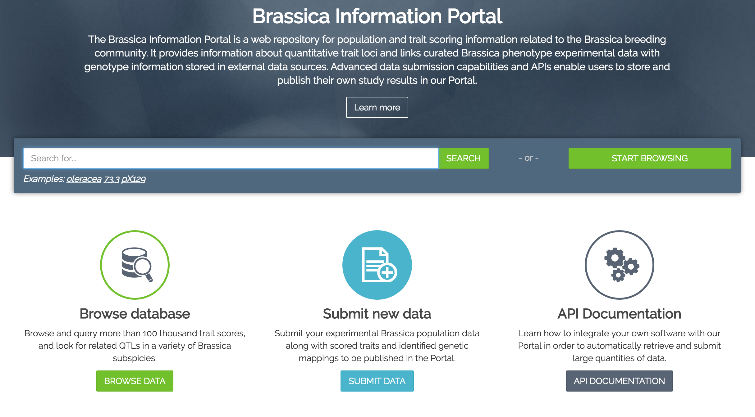
Population submission - extension -altering the ruby client
More metadata about the population
Alter ruby client accordingly
Open 2_population_submission.rb
FILE: 1b_BnaDFFS_genstatus

Slide 17
Population submission -altering the ruby client
Open 2_population_submission.rb
See instructions in the manual
Add variable GENETIC_STATUS
modify function create_plant_line
Add row[GENETIC_STATUS] to where function is called
Notes:
Latest developments were to obtain DOIs for datasets submitted to BIP. After 2 weeks of a dataset being published and not altered in the BIP, it is assumed to be “stable” and would be eligible for requesting a DOI. DOI is assigned through an external service called Zenodo.
- In your submissions, you can then request a DOI.
add some more metadata. Most of the metadata comes from the information you already gave when submitting to BIP. We have made most of the fields needed for a DOI submission already compulsory in the Trial submission process. It doesn’t need to be filled out twice. Some additional metadata is required according to DataCite standards.
instantly you receive the DOI and it is available and accessible online.
Once the data is submitted to Zenodo it cannot be changed. Therefore it is important to check the information submitted.

Slide 18
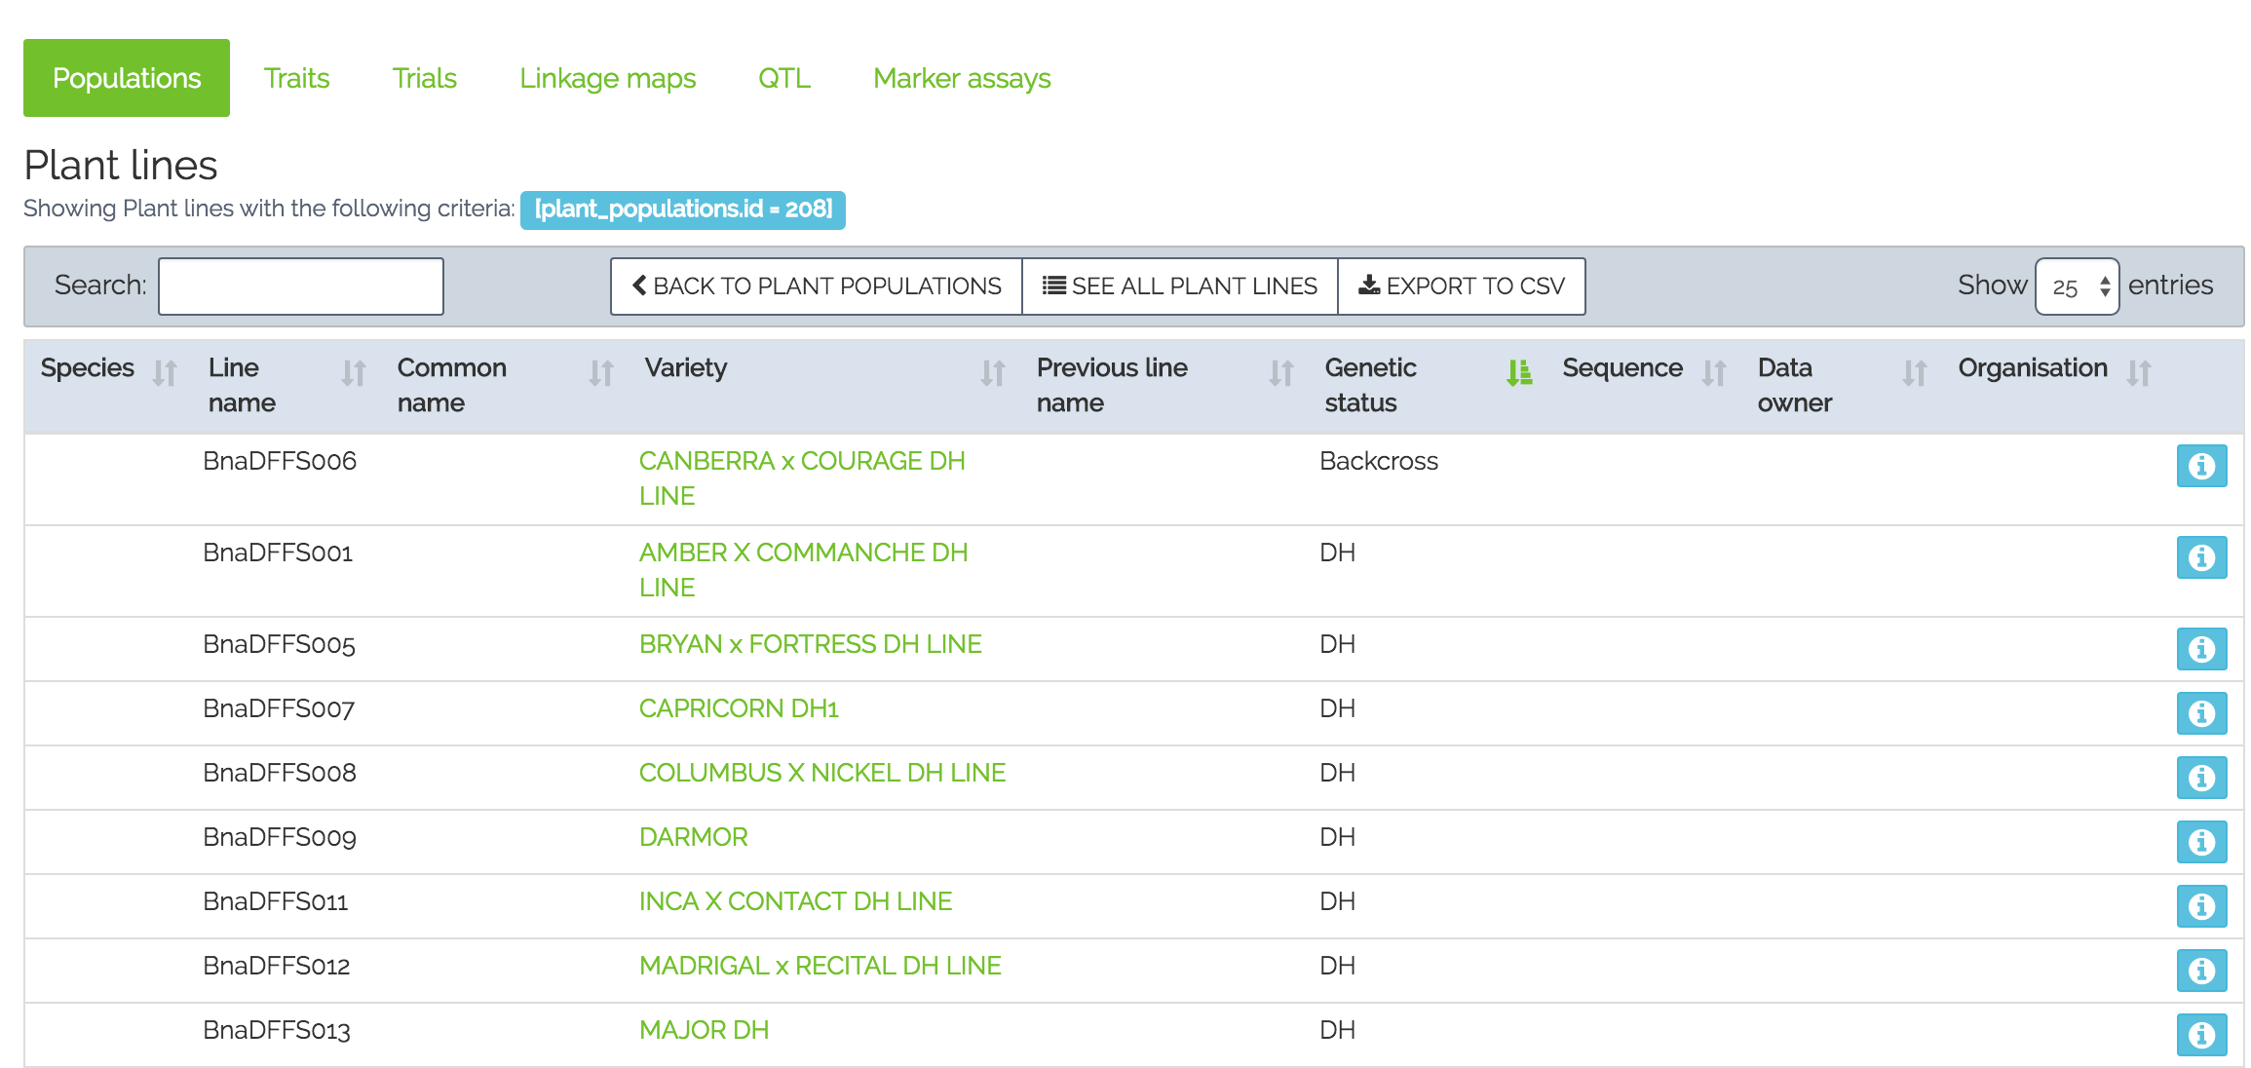
Population submission
Successful submission of a population, altering the ruby client to add submission of the ‘genetic status’ information.
Its display in the BIP:
Notes:
Latest developments were to obtain DOIs for datasets submitted to BIP. After 2 weeks of a dataset being published and not altered in the BIP, it is assumed to be “stable” and would be eligible for requesting a DOI. DOI is assigned through an external service called Zenodo.
- In your submissions, you can then request a DOI.
add some more metadata. Most of the metadata comes from the information you already gave when submitting to BIP. We have made most of the fields needed for a DOI submission already compulsory in the Trial submission process. It doesn’t need to be filled out twice. Some additional metadata is required according to DataCite standards.
instantly you receive the DOI and it is available and accessible online.
Once the data is submitted to Zenodo it cannot be changed. Therefore it is important to check the information submitted.

Slide 19
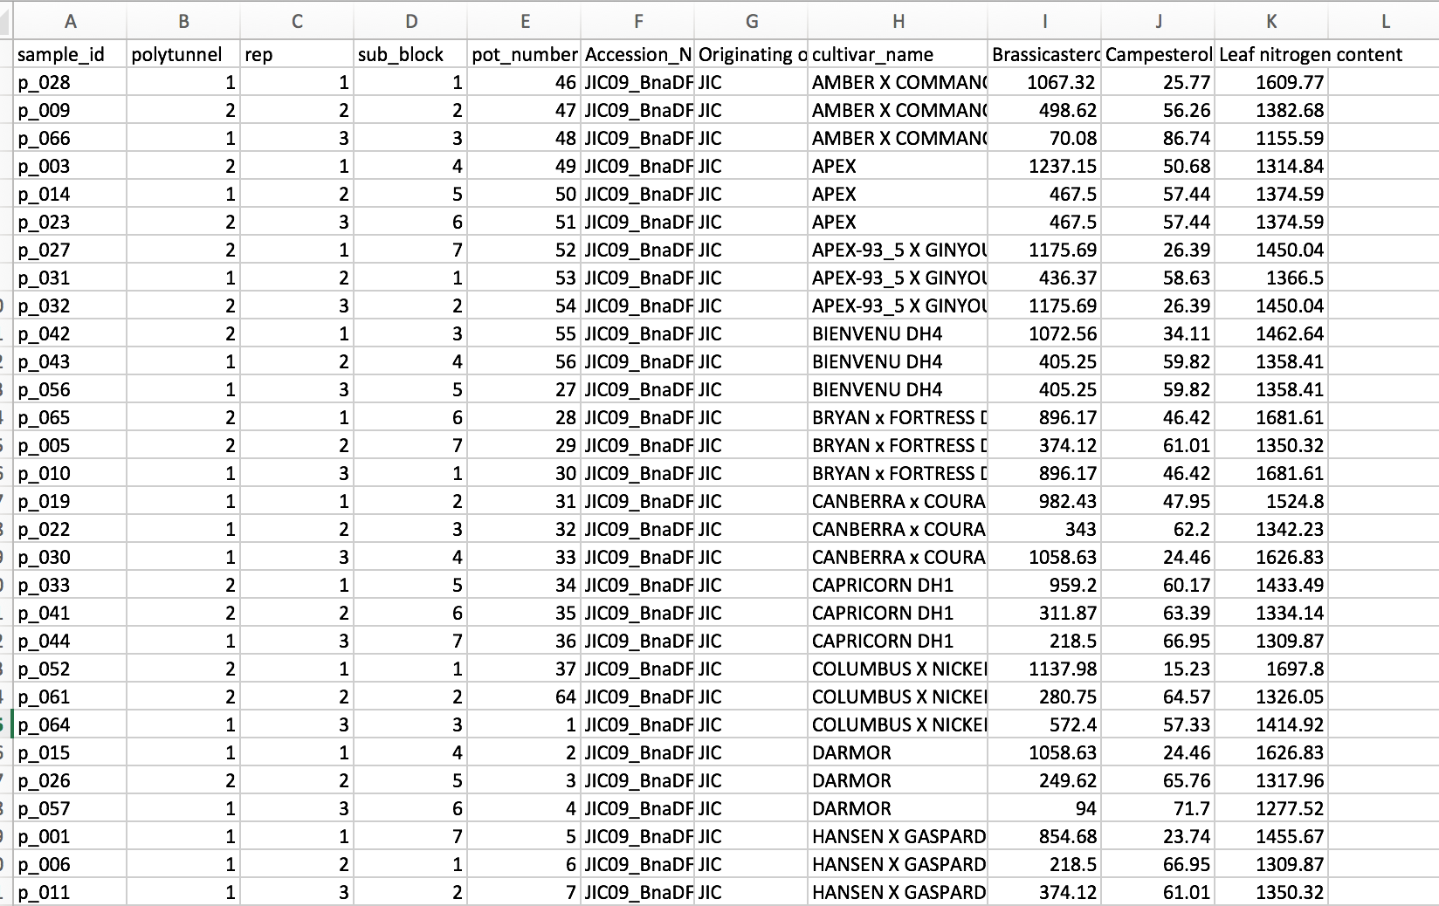
Trial data submission
22 lines
2 polytunnels, 3 reps, sub-blocks, pots
Morphological and biochemical traits measured
(each group of 2 has a trial data sheet each to work with)
Submit 3 trait measurements/trial sheet
Files 3_Trial_data_biochem
3_Trial_data_morph
Notes:
Chose among you and your partner which sheet you would like to submit- they are marked by 3_
-
You see that this is raw data that is going to be submitted to the BIP. You can see the experimental design, sample_id, cultivar information, and the traits that have been measured.

Slide 20
Trial submission
Trial data submission using the wizard. Go to bip.earlham.ac.uk
Notes:
In order to submit the Trial data, we go to bip.earlham.ac.uk, login and select trial submission- START!
I will do it myseld

Slide 21
Feedback on the submission process and the workshop is welcome!
Please send me an email to bip@earlham.ac.uk
Or talk to me after the workshop
Follow the BIP on Twitter: @BrassicaP
Thank you for attending!

Slide 22







Sarah Ayling
Wiktor Jurkowski
Tim Stitt
Anil Thanki
Robert Davey
Tomasz Gubała
Piotr Nowakowski
Tomek Szymczyszyn
Bartosz Chucherko
Erik Van den Bergh
Ramona Walls
Ambrose Andongabo
Pierre Carrion
Keywan Hassani-Pak
Chris Rawlings
Hanna Ćwiek, TransPlant
Ian Bancroft
Lenka Havlickowa
Zhesi He
Ian wood
RIPR
Acknowledgements
Graham King
Rachel Wells Judith Irwin
Dan Bolser
Guy Naamati

Slide 23
Annemarie Eckes
Data Curation, Plant Phenotyping
Annemarie.Eckes@earlham.ac.uk
@BrassicaPortal

Slide 24
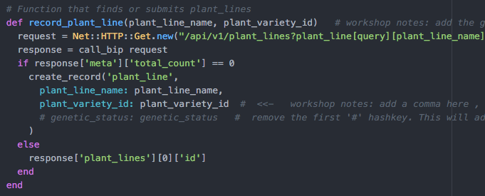
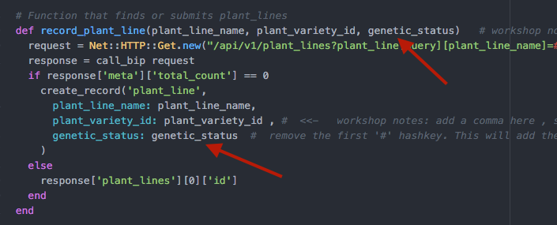
A
B
Notes:
This is an old slide which acts as a placeholder for an updated version. It needs to be updated based on the last developments.

